Slide 1

North South University
Dept. of computer science and engineering
Summer’2019
CSE323 Project
Section- 08
Group- 12

Slide 2
Submitted By:
Kamruzzman Shuvo - 1712071042
Faria Rahman Annasha - 1711438642
Md Sharif Hossain - 1712336642

Slide 3
Project Title: System Monitor
Platform: Windows

Slide 4
System Requirements:
Windows 7/8/10
Visual Studio environment setup
.NET Framework 4.7

Slide 5
Overview: This is a windows platform application which will act as a task manager of a computer. It will collect data of Model no, detailed processor information, CPU status, network status, physical and virtual memory status etc. from computer and show them in one platform.
We are using C# programming language on Visual Studio with .NET framework for this program.

Slide 6
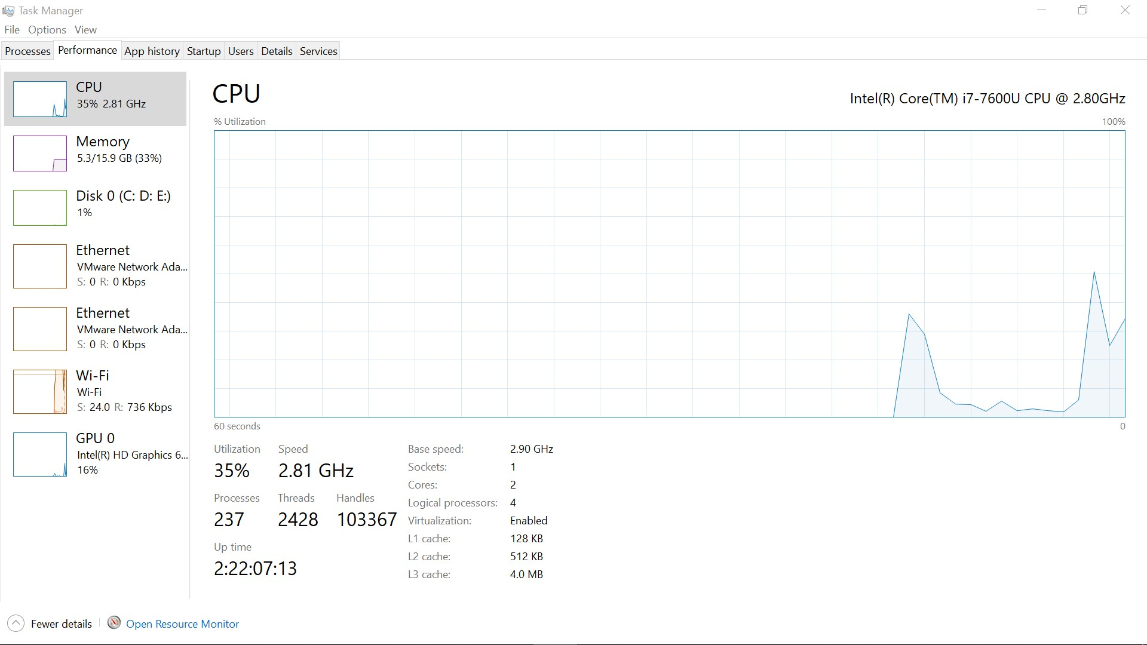
We’re familiar with this screen while viewing computer status. It is the default task manager of Microsoft OS.

Slide 7
Software construction:
Model no: It shows the architecture name and model, version of a computer
Processor: It shows the processor name with generation.
User: Shows user name of the operating system.
CPU: It shows the performance percentage of pc.

Slide 8
Software construction:
Usage history: It shows the past CPU usage graphically.
Mem V: Virtual memory is a memory management capability of an operating system (OS) that uses hardware and software.
Mem P: Primary memory is computer memory that is accessed directly by the CPU. It shows usage of RAM
Memory Usage History: It shows the RAM status graphically.

Slide 9
Software construction:
Disk R: It shows the HDD or SSD reading speed.
Disk W: It shows the HDD or SSD writing speed. So we can easily find if the disk is busy or not or how much busy it is.
Net I: It shows the uploading speed of internet.
Net O: It shows the downloading speed of internet.

Slide 10
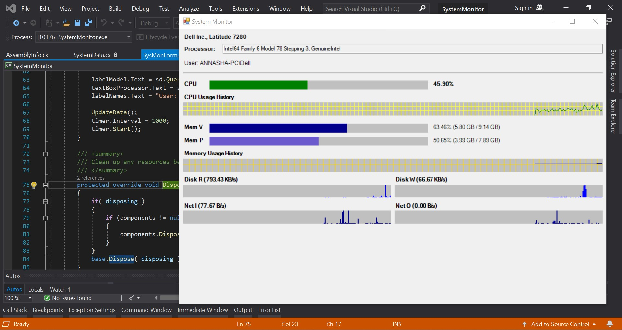
Application View

Slide 11
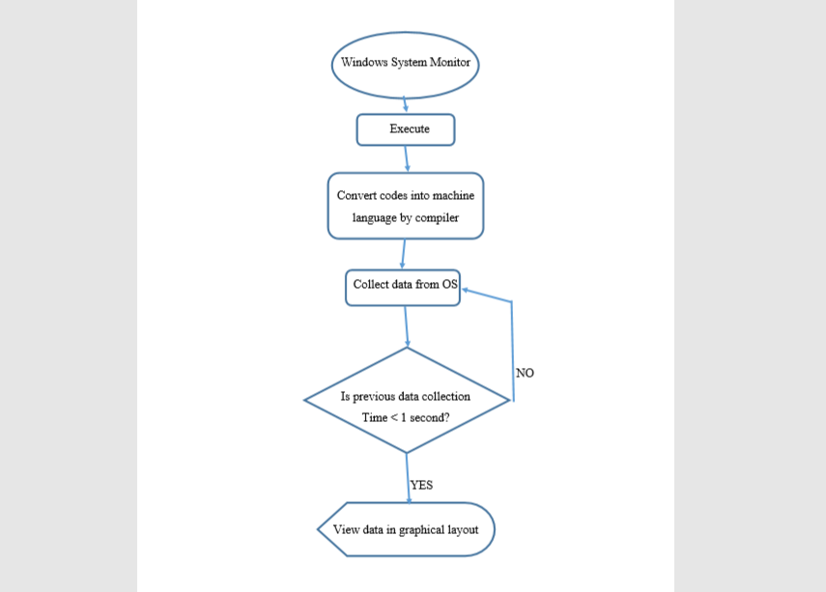
Work Flow

Slide 12
Project Contribution
Kamruzzman Shuvo: Software development (Windows form, C# language, some construction), work flow report writing.
Faria Rahman Annasha: Presentation slide, report writing, application layout.
Md Sharif Hossain: Work flow, report writing, timing and some other constructors in software.

Slide 13
Thank You!

Slide 14
?

